Slide 1
Digital Portfolio
STUDENT NAME: PRASUPTHA P
REGISTER NO AND NMID: 2422K2354
DEPARTMENT: BSC COMPUTER SCIENCE
COLLEGE: JCT COLLEGE OF ARTS AND SCIENCE / BHARATHIAR UNIVERSITY

Slide 2
PROJECT TITLE SIMPLE PORTFOLIO WEBSITE

Slide 3


AGENDA
Problem Statement
Project Overview
End Users
Tools and Technologies
Portfolio design and Layout
Features and Functionality
Results and Screenshots
Conclusion
Github Link
3/21/2024 Annual Review

Slide 4

PROBLEM STATEMENT The problem I am solving is to provide potential employers, clients, and collaborators with an easily accessible digital portfolio that showcases my skills, previous work, and contact information. This portfolio serves as a centralized platform where my achievements, experience, and projects are available at a glance, giving users a seamless experience when evaluating my work.

Slide 5

This project is a personal portfolio website that highlights my skills, projects I've worked on, and provides a way for visitors to contact me. The website is designed to be simple, responsive, and easy to navigate. It is fully coded with HTML, CSS, and JavaScript without relying on external libraries or frameworks. This website aims to present my technical abilities, creativity, and professionalism to potential employers or clients.
PROBLEM OVER VIEW

Slide 6

WHO ARE THE END USERS? The target audience for this portfolio includes: Potential Employers: HR teams and hiring managers who want to assess my technical skills and experience. Clients: People looking to hire me for freelance work or collaborations. Collaborators: Developers, designers, and other professionals who might want to collaborate on projects. Personal Use: As a personal branding tool to showcase and organize my work in one place.

Slide 7

TOOLS AND TECHNIQUES The portfolio was built using the following technologies: HTML: For structuring the content and layout. CSS: For styling the page and making it visually appealing. The design is responsive, ensuring a good user experience across all devices. JavaScript: For handling dynamic content like form submission and simple interactions (e.g., the contact form alert). Text Editor: Visual Studio Code (VSCode) for writing and editing code.

Slide 8
POTFOLIO DESIGN AND LAYOUT
The portfolio consists of a clean, minimalist layout with the following sections:
Header: Includes the title and a brief introduction to the portfolio.
About Me: A section to introduce myself, my skills, and my background.
Projects: A list of selected projects with brief descriptions of each.
Contact: A contact form for users to get in touch with me, along with an email link for further communication.
Footer: Contains basic copyright information.
The design emphasizes simplicity, focusing on usability and ease of navigation. I’ve used modern design principles to ensure that the website looks professional and works well on mobile devices.

Slide 9
FEATURES AND FUNCTIONALITY Responsive Design: The portfolio is mobile-friendly and adapts to various screen sizes. Contact Form: The form lets users submit their name, email, and message. Upon submission, the form triggers a JavaScript alert to confirm that the submission was successful. Project Listings: A clean list of my key projects with short descriptions. Interactive Elements: JavaScript is used to show alerts when the contact form is submitted. Simple Navigation: The layout allows users to quickly navigate between the different sections of the portfolio.

Slide 10
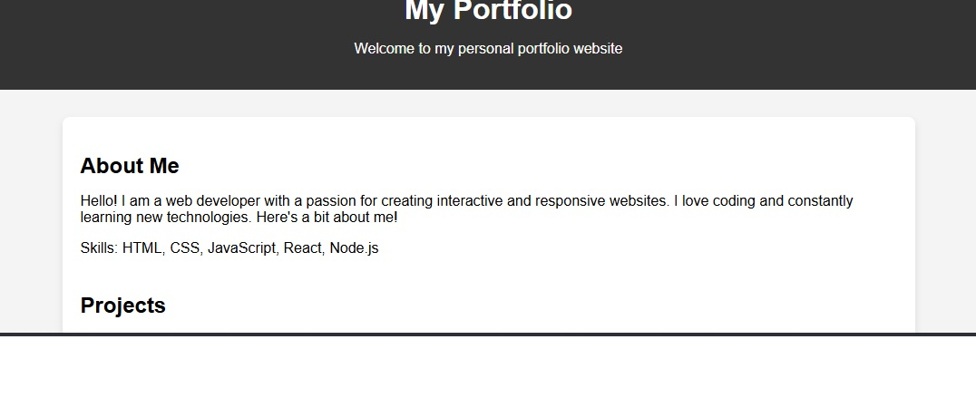

RESULTS AND SCREENSHOTS
3/21/2024 Annual Review

Slide 11
CONCLUSION In conclusion, this portfolio website provides a solid foundation for showcasing my web development skills and projects. It is built with a focus on simplicity and usability, ensuring that users can navigate the website with ease and find relevant information quickly. With this portfolio, I am able to highlight my technical abilities, creativity, and professionalism, giving potential employers and collaborators insight into my capabilities. The design and features can be further enhanced in the future, but it currently serves as an effective way to present myself as a developer in the digital space.

